Slide 1
Antibiotic amnesty 2023

Slide 2
Leftover antibiotics – what is the problem?
Of 500 UK patients prescribed antibiotics in previous 12 months:
14% had leftovers
Only 8% returned to pharmacy for safe disposal
Almost 1/3 threw them away
1/3 kept them for reuse
OECD report:
63% of medicines in UK are discarded in household waste
11% are discarded down toilets and sinks

Slide 3
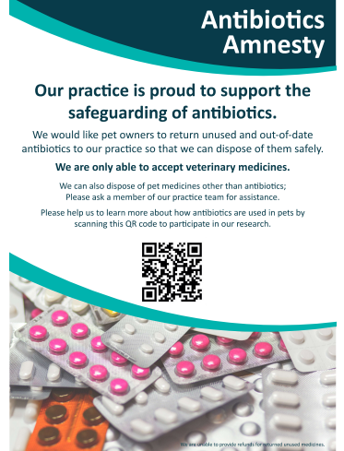
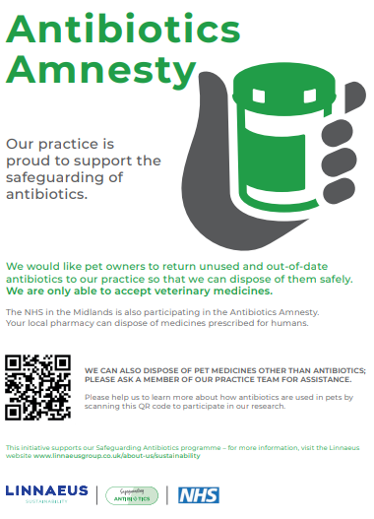
The Antibiotics Amnesty 2022
November 2022
Veterinary practices teamed up with NHS Midlands
One Health initiative
Encourage patients and pet owners to return unused or out-of-date antibiotics for proper disposal

Slide 4
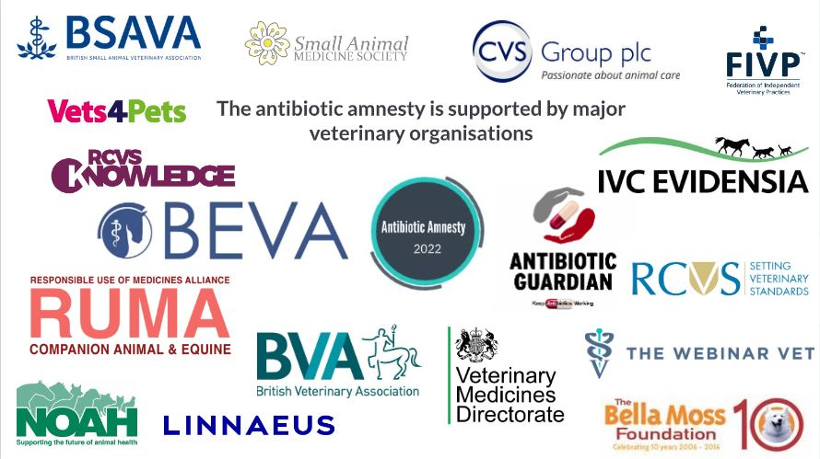

Slide 5
Outcomes
Return of > 750 antibiotic tablets, 12 part boxes of tablets, 53 bottles of antibiotic ear drops or ointments and 17 antibiotic injections
Including fluoroquinolones
Significant press and digital footprint
Companion, Vet Times, Vet Record, Dogs Monthly, Your Cat, Veterinary Practice, Veterinary Edge and Pet Business World
Thousands of views of the different resources and messages across different forms of social media
Written report, Companion update article and letter to Nature Medicine

Slide 6
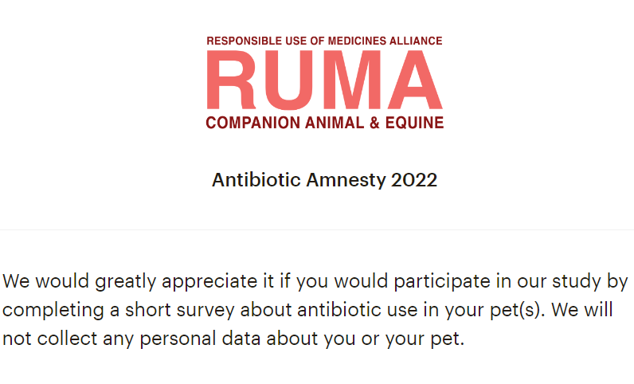
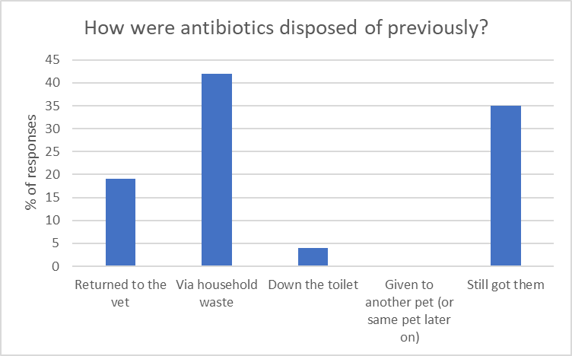
Client survey (n =139)
1st Nov. 2022
- 31st Dec. 2022
Total 24% with leftover antibiotics
37.8% (17/45) reported having had leftover abs previously
cf 14% McNulty et al. (people)

Slide 7
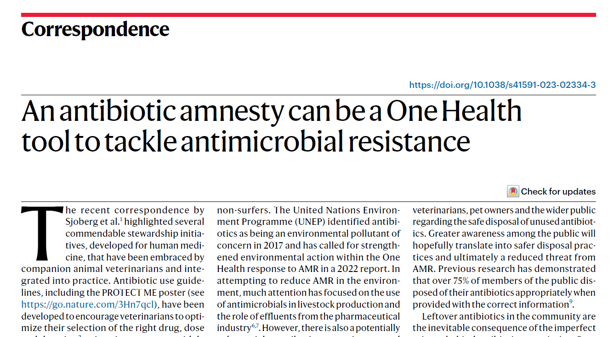

Slide 8
Amnesty 2023
Build on pilot project
Amazing engagement of key stakeholders
Lessons learned
Earlier roll out
Monthly meetings
Broaden involvement
Global outreach
Different species
Maintain a One-Health perspective

Slide 9
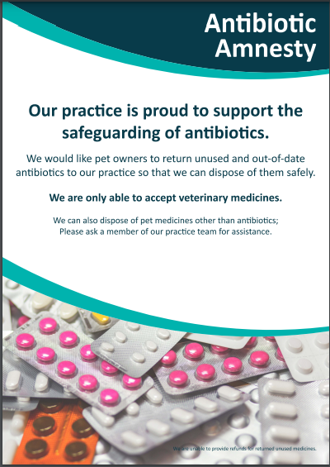
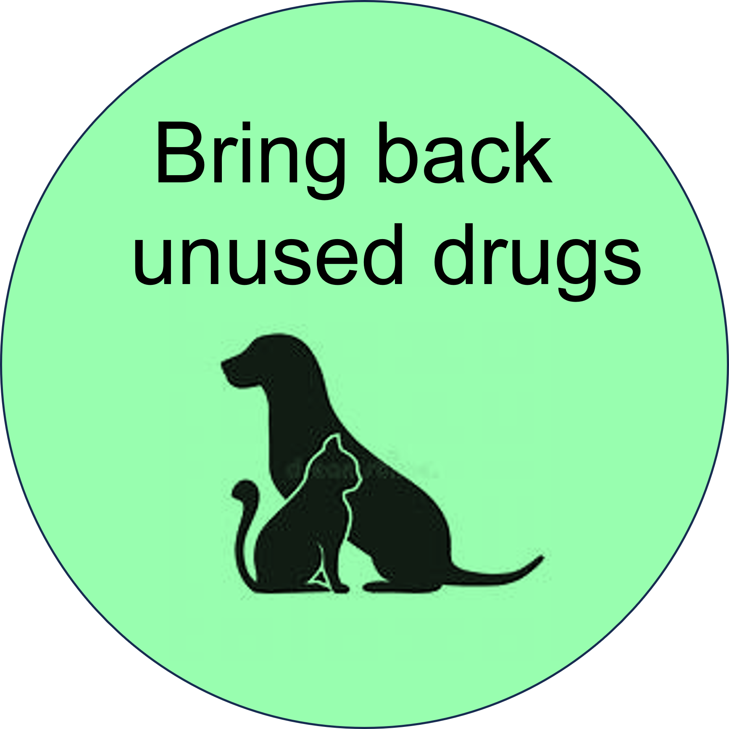
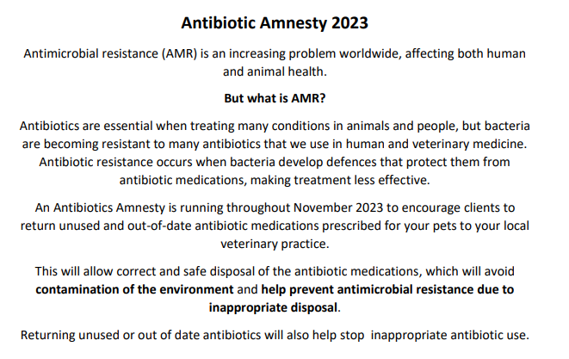
Accessible assets
https://rumacae.org.uk/vet-antibioticamnesty/
https://knowledge.rcvs.org.uk/amr/antibiotic-amnesty/

Slide 11
Thank you

